Slide 1

Artificial Intelligence
BATCH – 17 :
Shanmukha Sudha Kiran . T – 211FA04003
Ravi Kiran . K – 211FA04043
Siva Sree Deepthi . U – 211FA04046
Sahil Raj - 211FA04677
SEC – A , 3rd B.TECH, DEPT - CSE

Slide 2
Table of contents
01
02
03
04
AIM
PROBLEM STATEMENT
INTRODUCTION
ALGORITHM
05
SOURCE CODE
06
TEST CASE
07
RESULT
08
CONCLUSION

Slide 3
AIM :
The Aim of the Question is to evaluate the participants proficiency in utilizing resolution within the frameworks of first order logic. By presenting scenarios involving statements about mortality, family relationships, and logical arguments, the question assesses the individual’s grasp of representing information in first order logic and employing resolution to either establish the validity of statements, deduce familial connections, or solve complex puzzles. Through these exercises, the participant is expected to showcase lodical reasoning skills, critical thinking abilities, and problem solving acumen in the context of formalized logical systems, ultimately demonistrating a comprehensive understanding of how resolution operates in the realm of first order logic.

Slide 4
PROBLEM STATEMENT :
A) Using resolution in first-order logic, prove or disprove the statement: "All humans are mortal. Socrates is a human. Therefore, Socrates is mortal."B) Given a first-order knowledge base representing a family tree, use resolution to find out if John is Susan's uncle.C) Use resolution in first-order logic to determine the validity of the argument: "If all men are mortal, and Socrates is a man, then Socrates is mortal."D) Consider a first-order logic knowledge base representing a complex puzzle or game. Use resolution to find a solution to the puzzle or determine if it is unsolvable.E) Given a knowledge base describing a set of university courses, professors, and students, use resolution to find out if there is a professor who teaches all courses.

Slide 5
INTRODUCTION :
The problem statement introduces a series of challenges centered around the application of resolution in the context of first-order logic. With a focus on logical reasoning and problem-solving, the question addresses various scenarios, including statements about human mortality, family relationships, and general logical arguments. Each part of the question presents a specific task, such as proving the mortality of Socrates, determining familial connections, validating logical arguments, or solving complex puzzles—all through the lens of first-order logic and the resolution inference method. The collective aim is to assess the participant's ability to navigate and manipulate formalized logical systems, showcasing their proficiency in utilizing resolution for reasoned conclusions within diverse logical scenarios.

Slide 6
ALGORITHM :
Start
Express the given information and statements in first order logic
Define the intial set of clauses based on the knowledge base
Clearly state the goal or the statement you aim to prove or disprove in first order logic
Use the resolution inference rule iteratively until either a contradiction is derived or no further resloutions can be made
Add the negation of the goal statement to the set of clauses
If a contradiction is derived during the resolution process, the original statements are consistent, and the goal is proved
If no further resolutions can be made, and the goals negation remains, then the goal is disproved
If the goal is proved, interpret the result accordingly
If the goal disproved, interpret the result accordingly
If there are multiple parts to the problem statement, repeat steps for each scenario
Stop

Slide 7
SOURCE CODE :
<!DOCTYPE html>
<html lang = “en”>
<head>
<meta charset = “UTF-8”>
<meta name = “viewpoint” content = “width=device-width,initial-scale=1.0”>
<title>First Order Logic Proof</title>
<link href = “style.css” rel = “stylesheet”>
</head>
<body>
<div class = “main1”>
<h2>Here are 3 statements: (1, 2 act as input) and we want to prove or disprove the statement 3 using First Order Logic</h2>
<h2>1. All Humans are <select id="statement1">
<option value="Mortal">mortal</option>
<option value="not Mortal">not mortal</option>
</select>
</h2>
<h2>2. Socrates is <select id="statement2">
<option value="Human">Human</option>
<option value=“not Human”>not Human</option>
<option value="not Human">not Human</option>
</select></h2>
<h1>Therefore:</h1>
<h2 class="hp">Socrates is <select id="thereforeStatement">
<option value="Mortal">Mortal</option>
<option value="not Mortal">not Mortal</option>
</select></h2>
<button id="calculateButton" onclick="givenoutput()">Calculate Overall Statement</button>
<h2>Overall Given Statement is:</h2>
<p id="output1"></p>

Slide 8
<button id="calculateButton" onclick="answer()">Check Answer</button>
<h2>Answer:</h2>
<p id="output2"></p>
<!-- <button id="final" onclick="answer()">Check Answer</button> -->
</div>
<script>
function givenoutput() {
var statement1 = document.getElementById("statement1").value;
var statement2 = document.getElementById("statement2").value;
var thereforeStatement = document.getElementById("thereforeStatement").value;
var overallStatement = "All Humans are " + statement1 + ", Socrates is " + statement2 + ". Therefore, Socrates is " + thereforeStatement;
document.getElementById("output1").innerText = overallStatement;
}
function answer() {
var statement1 = document.getElementById("statement1").value;
var statement2 = document.getElementById("statement2").value;
var thereforeStatement = document.getElementById("thereforeStatement").value;
if ((statement1 === 'Mortal' && statement2 === 'Human') || (statement1 === 'not Mortal' && statement2 === 'not Human')) {
if (thereforeStatement === 'Mortal') { document.getElementById("output2").innerText = "Proven"; button.style.display = "none";
}

Slide 9
else
{ document.getElementById("output2").innerText = "Disproven";
const button = document.createElement('button’);
button.textContent = 'Get Answer’;
button.addEventListener('click', () =>
{
const paragraph = document.createElement('p’);
paragraph.textContent = "All Humans are " + statement1 + ", Socrates is " + statement2 + ". Therefore, Socrates is mortal";
// document.body.appendChild(paragraph);
alert(paragraph.textContent);
location.reload();
});
document.body.appendChild(button);
}
} else if ((statement1 === 'not Mortal' && statement2 === 'Human') || (statement1 === 'Mortal' && statement2 === 'not Human’))
{
if (thereforeStatement === 'not Mortal’)
{
document.getElementById("output2").innerText = "Proven";
button.style.display = "none";
}
Else
{
document.getElementById("output2").innerText = "Disproven";
const button = document.createElement('button');
button.textContent = 'Get Answer’;
button.addEventListener('click', () => {
const paragraph = document.createElement('p’);
paragraph.textContent = "All Humans are " + statement1 + ", Socrates is " + statement2 + ". Therefore, Socrates is not mortal";
// document.body.appendChild(paragraph);
alert(paragraph.textContent);
location.reload();
});
document.body.appendChild(button);
}}}
</script>
</body>
</html>

Slide 10
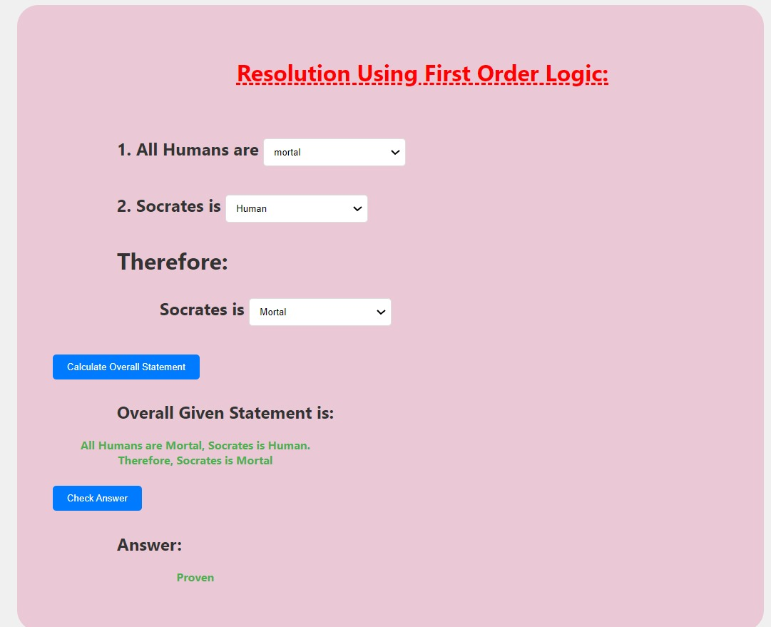
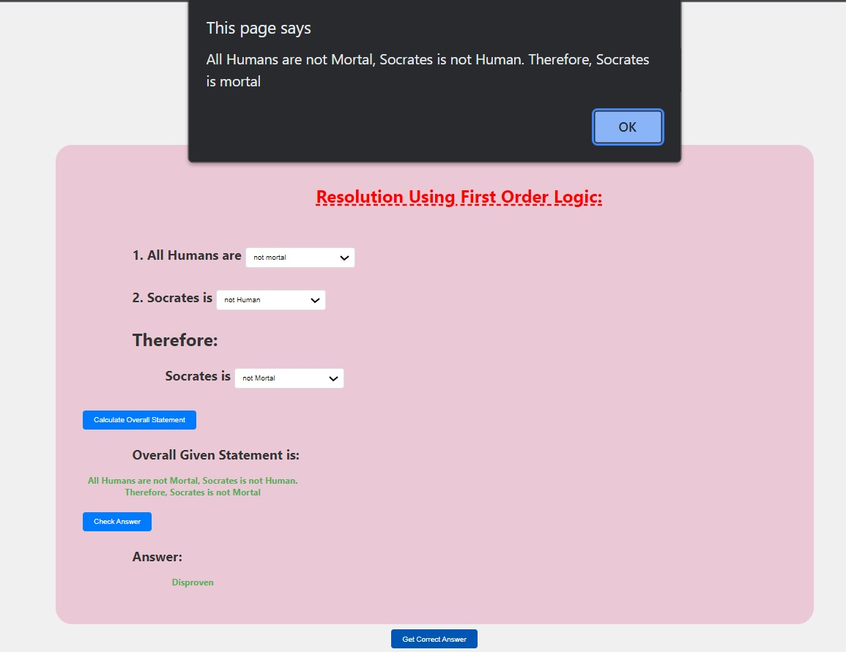
TEST CASES :

Slide 11
RESULT :
The result of the problem statement is determined by the application of the resolution algorithm to the specific test cases provided. The algorithm aims to either prove or disprove a given goal statement based on the information encoded in a first-order logic knowledge base. If the algorithm successfully derives a contradiction during the resolution process, it indicates that the goal is logically supported by the knowledge base, and thus, the goal is proved. On the other hand, if no further resolutions are possible and the negation of the goal persists, it suggests a lack of logical support for the goal, resulting in its disproval. The interpretation of the result hinges on the specific content of the knowledge base, the goal statement, and the rules of the logic system, illustrating the algorithm's effectiveness in logical reasoning within a first-order logic context.

Slide 12
CONCLUSION :
In conclusion, the problem statement presented a series of challenges involving first-order logic and the resolution method to prove or disprove statements. The algorithm, structured for logical reasoning and problem-solving, was applied to scenarios such as affirming Socrates' mortality, determining family relationships, and validating logical arguments. The success of the algorithm depended on its ability to derive contradictions or affirmations through the resolution process. The outcome demonstrated the algorithm's proficiency in navigating formalized logical systems and drawing conclusions based on the given knowledge base. Through these exercises, the problem statement served as a comprehensive assessment of the participant's competence in applying resolution in first-order logic for logical inference and reasoning.

Slide 13
THANK YOU

